Slide 1
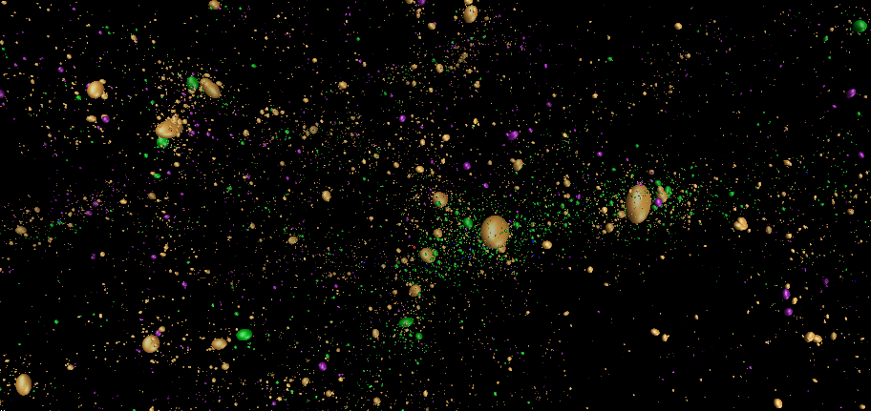
Astrophysical Phenomena Visualizations
Reagan’s Renderers
Alex Bogert, John Holdener, Conor Kaminer, Nathan Nichols-Roy, Nolan Ohliger, Nicholas Smith

Slide 2
Problem Statement
Visualize and interact with large data
Utilize CUDA/OpenGL to render on GPU rather than CPU

Slide 3
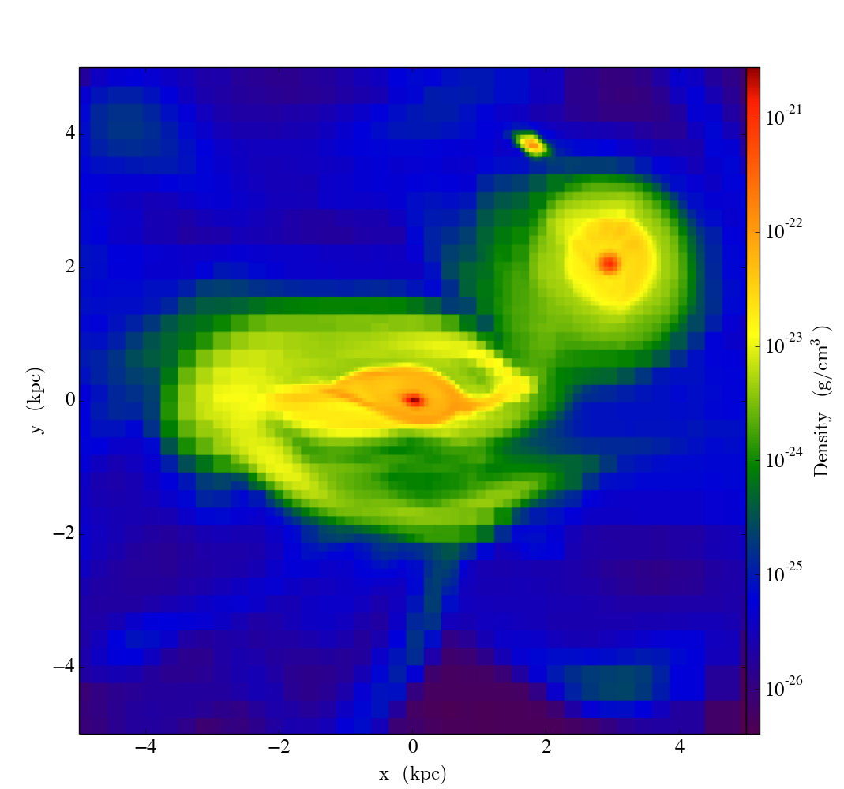
Visualization in YT
Density projection plot of Galaxy data
Quick way to visualize data on 2d plane
Not interactive

Slide 4
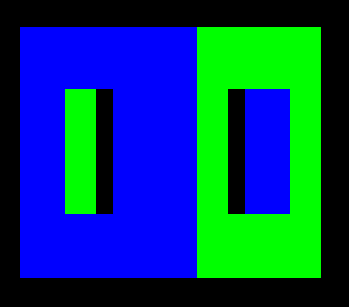
Simple OCTree Render In OpenGL
First test of rendering OCTree data.
Done remotely with VirtualGL.
User is able to rotate the cube and zoom in and out via mouse and Keyboard

Slide 5
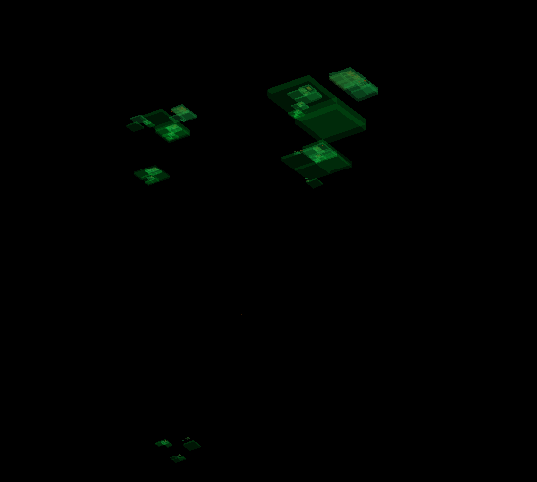
Complicated OCTree Test in OpenGL
Same program as Simple test on a more complicated dataset.
Reveals there is something wrong with the program, the data, or both.
Visual presentation not particularly pleasing.

Slide 6
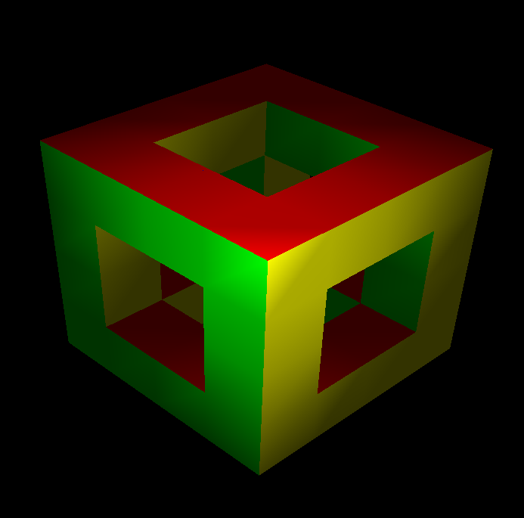
Techniques For Visualizing OCTrees
Phong Shading in OpenGL.
Uses the simple OpenGL example.
Refactored for modern OpenGL.
All data moved to a pixel bugger to allow real time shading.
Looks much nicer and provides more information.

Slide 7
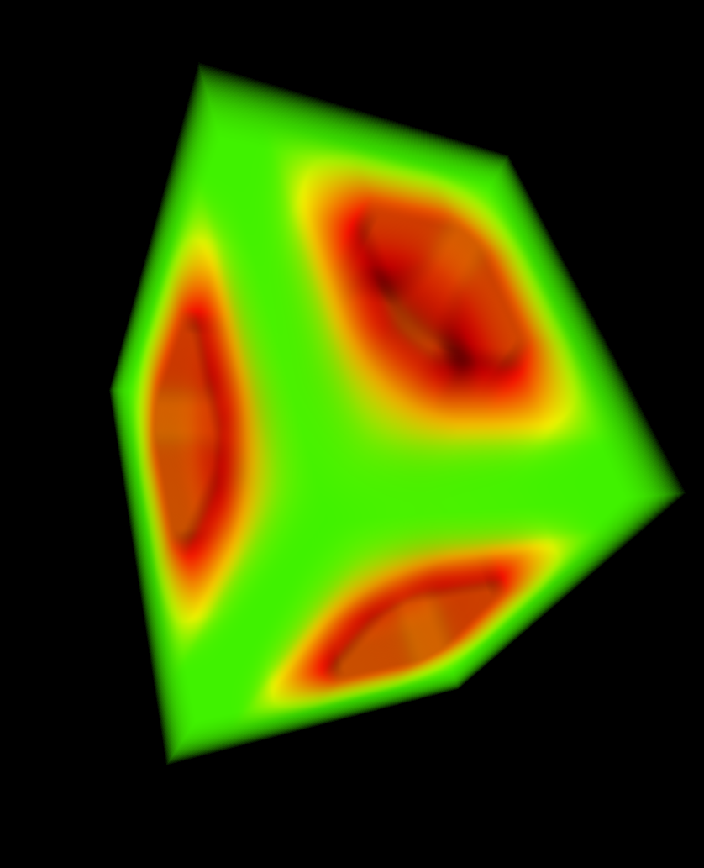
Techniques For Visualizing OCTrees
Simple ray-casting technique for volume rendering.
Adopted to render OCTrees.
This allows for robust volume rendering due to the parallel nature of the graphics card.

Slide 8
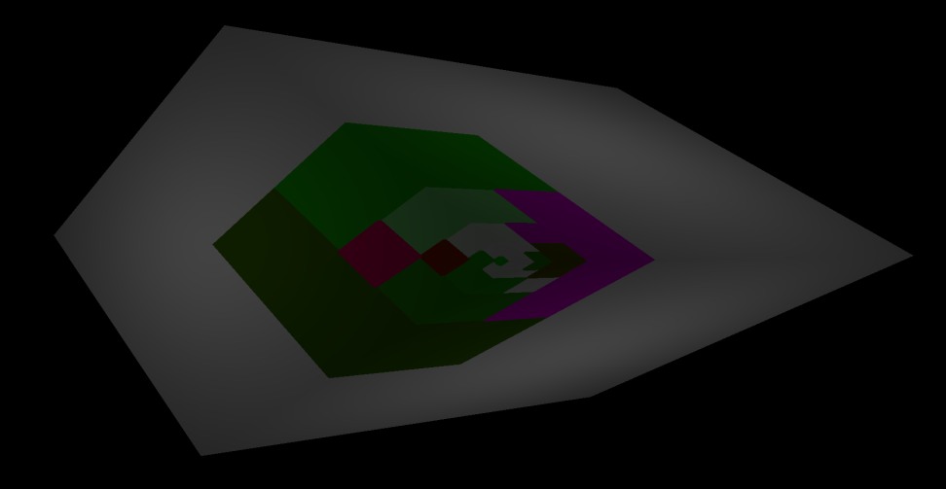
Techniques For Visualizing OCTrees
Implementation of a popular 3D imaging technique to see how it varied from CUDA ray-casting.
Reveals things differently from other OCTree renders.

Slide 9
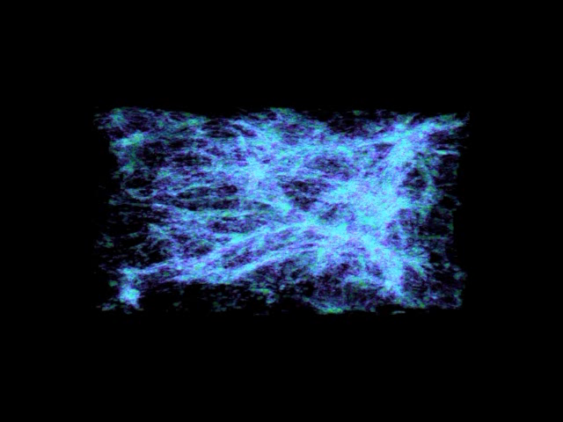
Volumetric Sheets Demo

Slide 10
Accomplishments
CUDA Volume Renderer
Integration with YT
Support for grid and OCTree data

